Slide 1
DDoS Attack Detection Using Machine Learning & Traffic Flow Dashboard
Network Traffic Classification & Visualization Dashboard
Created by :- Pavan Lade

Slide 2
INTRODUCTION / PROBLEM STATEMENT
Introduction
Content:
DDoS attacks disrupt network services
Traditional detection methods are rule-based
These methods fail against new attack patterns
Machine learning offers adaptive detection
Problem Statement
Content:
High volume network traffic is hard to analyze
Attack traffic looks similar to normal traffic
Manual monitoring is time-consuming
Need an automated and intelligent solution

Slide 3
PROJECT OBJECTIVE / DATASET OVERVIEW / TOOLS & TECHNOLOGIES / DATA PREPROCESSING
Project Objective
Content:
Detect DDoS attacks from network traffic
Classify traffic as Attack or Normal
Reduce false alarms
Visualize traffic behavior using a dashboard
Dataset Overview
Content:
ISCX DDoS Network Traffic Dataset
Approximately 226,000 traffic flows
Real-world network traffic data
Contains normal and attack flows
Tools and Technologies
Content:
Python (Pandas, NumPy)
Scikit-learn, XGBoost
SMOTE for class imbalance
Power BI for dashboard visualization
Data Preprocessing
Content:
Removed missing and infinite values
Cleaned column names
Encoded attack labels
Balanced training data using SMOTE

Slide 4
FEATURE ENGINEERING / MODEL BUILDING / ENSEMBLE LEARNING / MODEL EVALUATION
Feature Engineering
Content:
Packets per second
Bytes per second
Forward to backward packet ratio
Flow duration-based metrics
Machine Learning Models
Content:
Decision Tree (baseline model)
Random Forest
Extra Trees
XGBoost
Highlight:
Final Model : Soft Voting Ensemble
Ensemble Learning Approach
Content:
Combines multiple ML models
Improves detection accuracy
Reduces false positives
More stable than single models
Model Evaluation
Content:
Precision, Recall, F1-score
Confusion Matrix
Strong performance in detecting attacks
Ensemble outperformed individual models

Slide 5
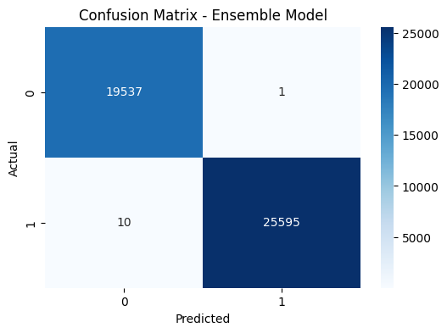
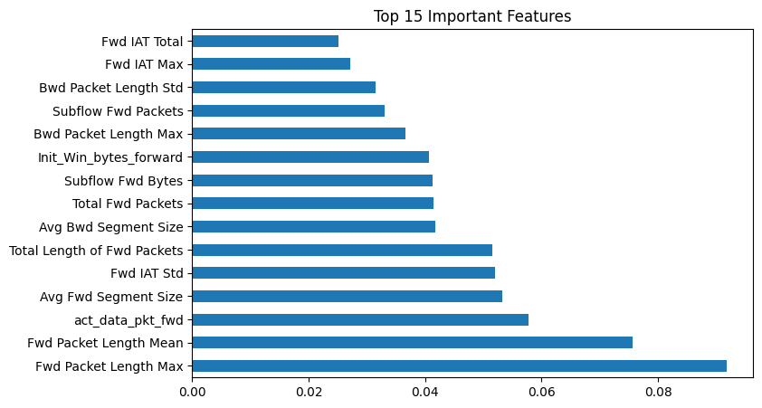
Model Evaluation Results (Confusion Matrix & top 15 Feature Importance)

Slide 6





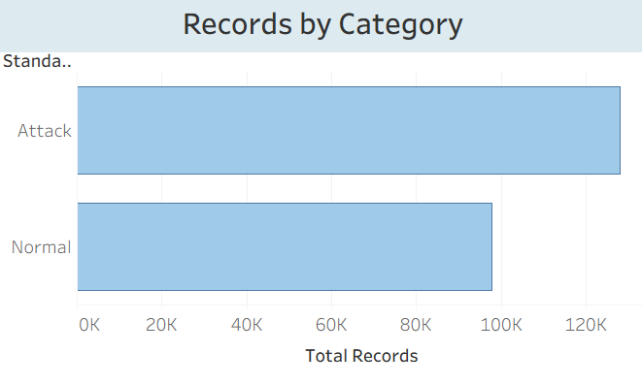
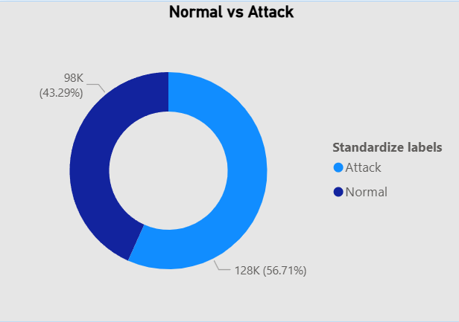
DASHBOARD OVERVIEW - Traffic Summary

Slide 7
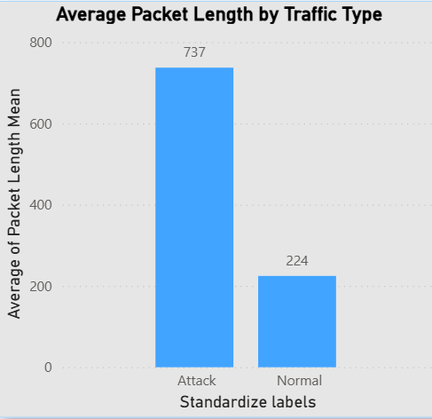
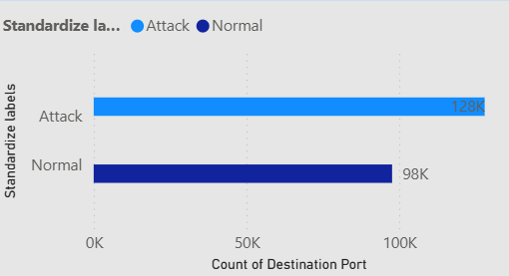
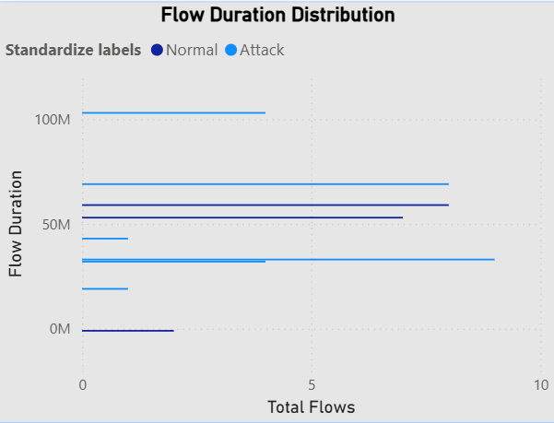
PACKET BEHAVIOR ANALYSIS / Destination port / FLOW DURATION ANALYSIS

Slide 8
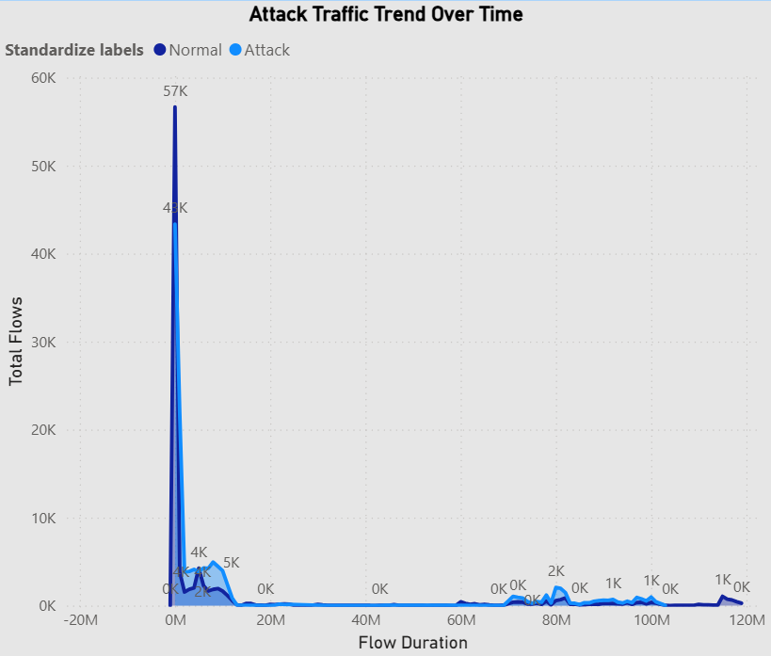
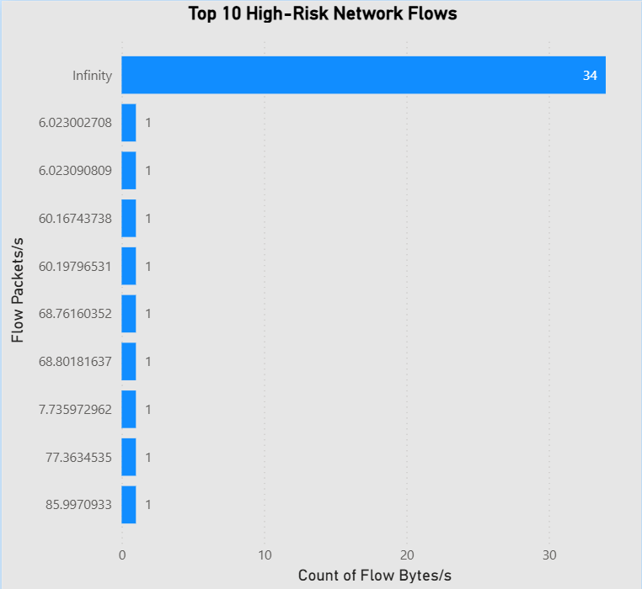
ATTACK TRAFFIC TREND / HIGH-RISK NETWORK FLOWS (Top 10)

Slide 9
BUSINESS IMPACT / FUTURE ENHANCEMENTS
FUTURE ENHANCEMENTS
Explainable AI
Real-time traffic detection
Deployment using web applications
BUSINESS IMPACT
Early attack detection
Reduced downtime
Improved SOC visibility
Faster response

Slide 10
CONCLUSION
End-to-end DDoS detection system
Machine learning + visualization
Practical cybersecurity solution
THANK YOU

